Slide 1

Window Functions in MySQL with Python Integration
M. Tech. – DSML → Team 7
Date: 24th Oct 2020
MySQL – Project Presentation
PRAVEEN MANOHAR G
RAHUL A
RAJESH RAMACHANDER
RANJITH GNANA SUTHAKAR ALPHONSE RAJ

Slide 2
AGENDA
Overview of Window Functions
Database Considered For Case Study
Case Study
Learnings & Conclusions
Window Functions in MySQL with Python Integration – Team 7

Slide 3
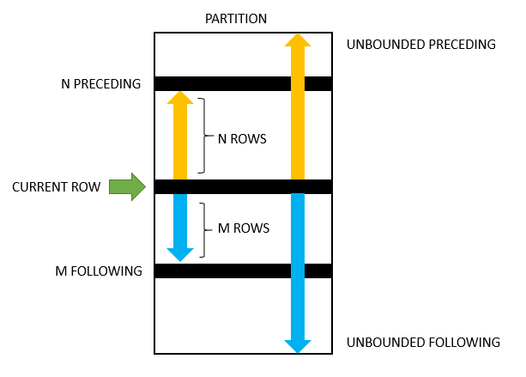
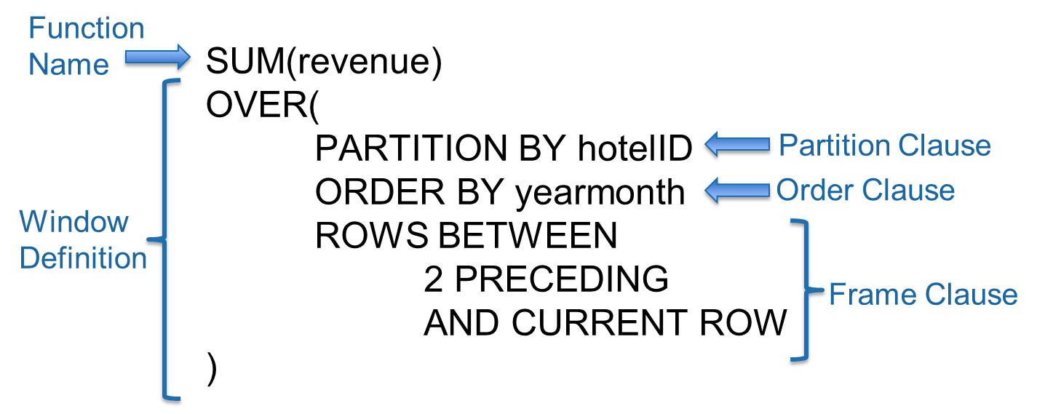
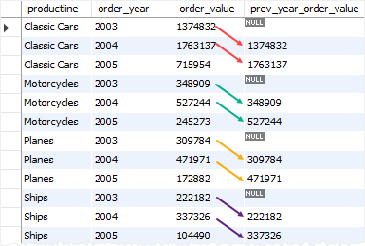
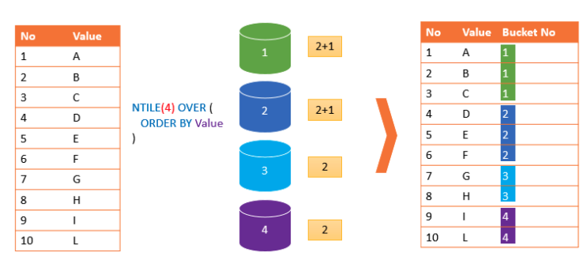
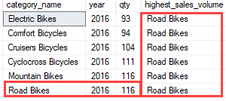
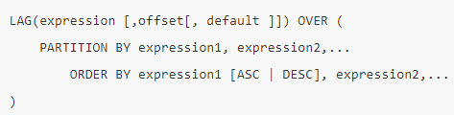
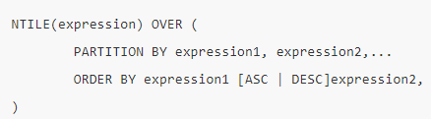
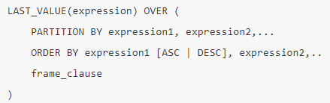
Overview of Window Functions
Window functions allow us to perform calculations against sets or subsets of rows within a query
Parts of a Window Function
Types of Window Functions
Aggregate:
SUM, MIN, MAX, COUNT, AVG,…
Ranking: ROW_NUMBER, RANK, DENSE_RANK, NTILE,…
Distribution/ Analytic functions:
CUME_DIST, FIRST_VALUE, LAST_VALUE, LAG, LEAD, PERCENTILE_CONT, PERCENTILE_DISC, PERCENT_RANK
Running 3 Month Sum
LAG () Function
NTILE () Function
LAST_VALUE () Function
SQL LAG() is a window function that provides access to a row at a specified physical offset which comes before the current row.
NTILE() function is a window function that divides an ordered result set into a number of buckets by a specified expression and assigns an appropriate bucket number to each row.
The LAST_VALUE() is a window function that allows you to obtain the value of the last row in a specified window frame.
Syntax →
Syntax →
Syntax →
Window Functions in MySQL with Python Integration – Team 7

Slide 4
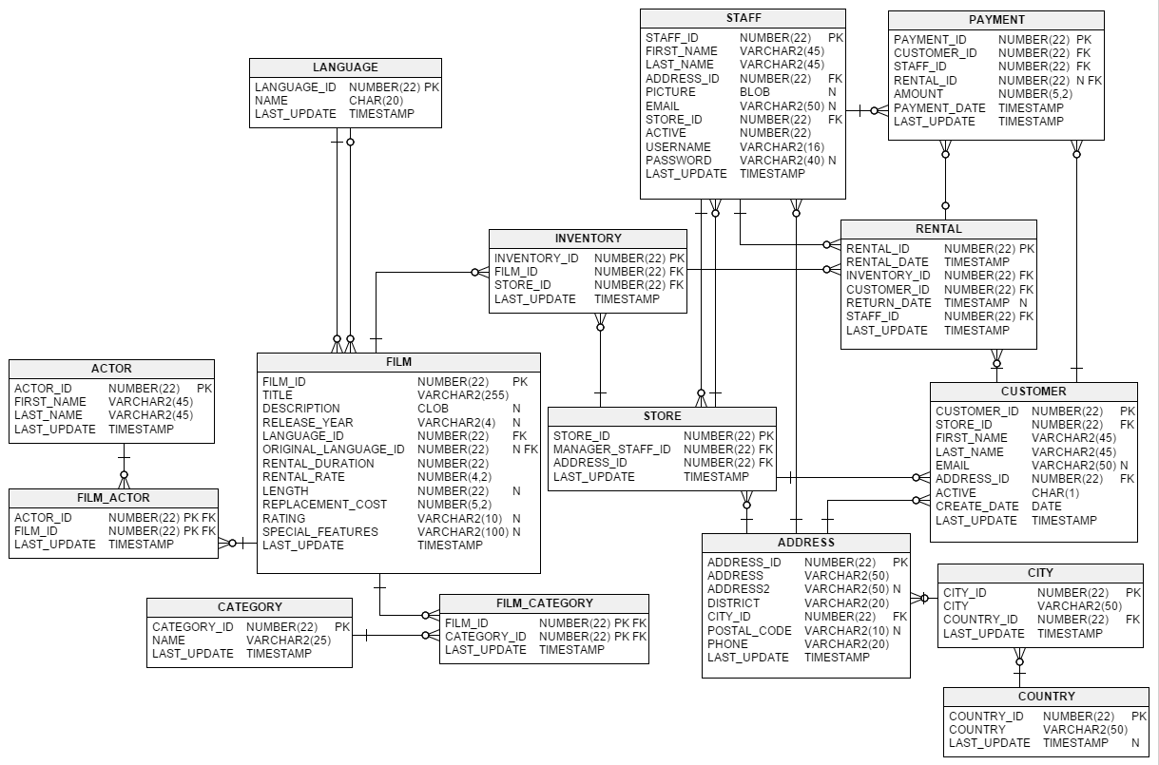
Database Considered For Case Study
Database → SAKILA
Database of a DVD rental store, featuring things like films, actors, film-actor relationships, and a central inventory table that connects films, stores, and rentals along with customer details
No. of tables → 15
Window Functions in MySQL with Python Integration – Team 7

Slide 5
Case Study
Based on SAKILA store database
Window Functions in MySQL with Python Integration – Team 7

Slide 6
Case Study Overview
Business Objective:
The SAKILA DVD store is taking Business Development initiatives. On this the team wants to increase the renting count/ frequency from customers and judiciously stock the stores with newer film titles to maximize revenue gains frugally.
Data Analytics Objective:
Understanding and profiling customers based on rental records in the database
Identify areas of restocking based on rental revenue from the database
Questions:
What percentage of customers generally hold >1 rentals at a time?
What are the top earning film genres for stocking accordingly?
What is the frequency of payment services offered by each staff?
Window Functions in MySQL with Python Integration – Team 7

Slide 7
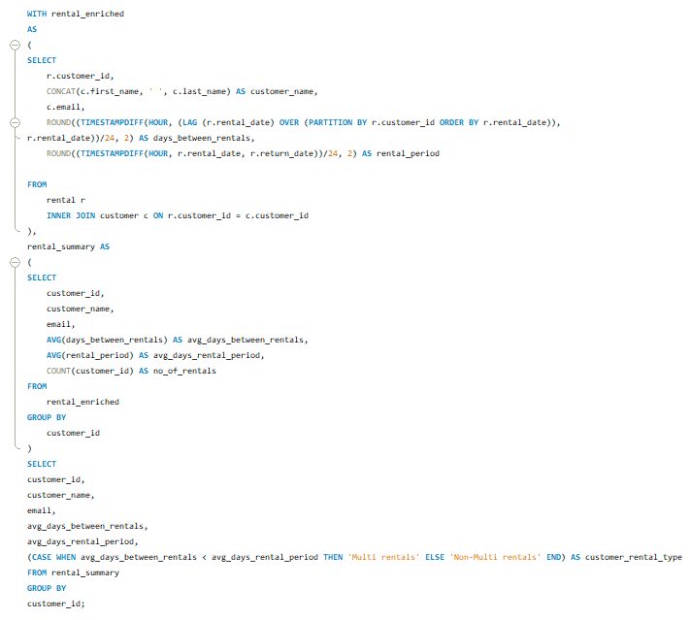
Q1. What percentage of customers generally hold >1 rentals at a time?
Customer profiling based on average days between rentals and average rental period
Querying Steps:
Calculate the time duration between successive rentals by each customer using the LAG function from the ‘rental’ table
Calculate the time duration of each rental by taking the difference between rental_date and return_date
For each customer calculate the average duration between rentals and average rental period
Based on the average fields identify customers who generally rent a second title before returning the first one (Multi rentals)
IF [avg_days_between_rentals < avg_days_rental_period], then classify the customer as ‘Multi rentals’ customer ELSE ‘Non-Multi rentals’
Window Functions in MySQL with Python Integration – Team 7

Slide 8
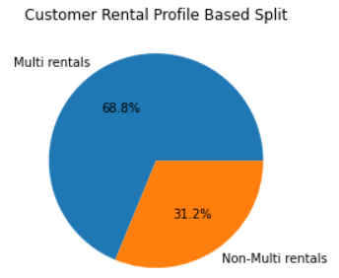
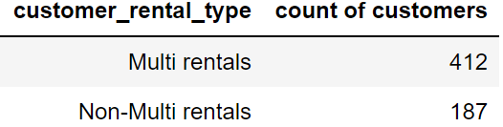
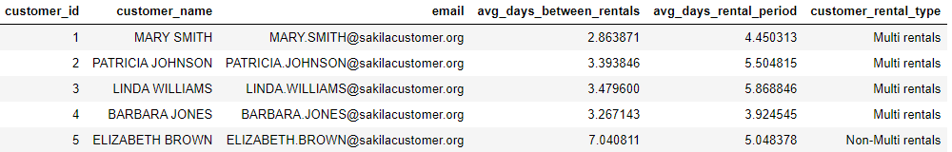
Q1. What percentage of customers generally hold >1 rentals at a time?
Customer profiling based on average days between rentals and average rental period
‘Multi rental’ customer → Customers who generally rent a second title before renting the first one
‘Non-Multi rental’ customer → Customers who generally rent one title at a time and return the same before the next rental
Observations:
There are 599 customers in the SAKILA database
~69% of them in general hold multiple rentals at a time
A greater percentage of customers generally look to hold multiple rentals at a time, at ~69% (412 out of 599)
Business suggestion:
The ‘Non-Multi rentals’ customers can be potentially be reached with some offers to rent multiple films to increase rental frequency
Window Functions in MySQL with Python Integration – Team 7

Slide 9
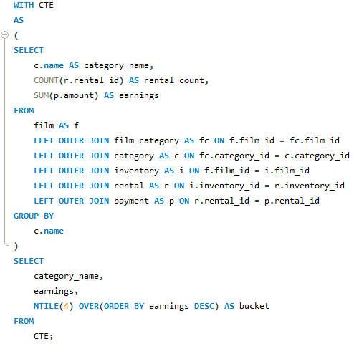
Q2. What are the top earning film genres for stocking accordingly?
Bucket film genres into 4 levels of rental earnings from the data
Querying Steps:
Build a master table by joining tables film, film_category, film, rental, inventory and payment
Calculate total earnings and count of films per genre
Classify film genre in 4 quartiles based on the earnings using the NTILE() function
Window Functions in MySQL with Python Integration – Team 7

Slide 10
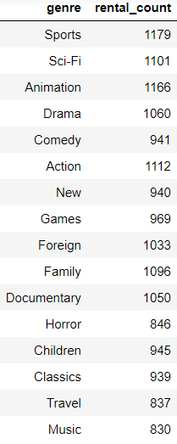
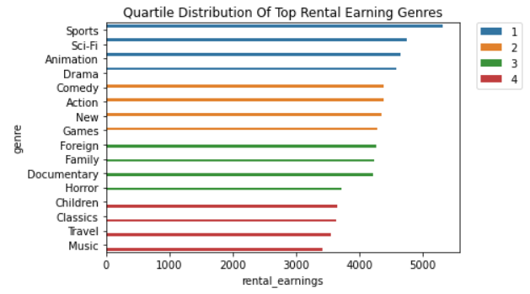
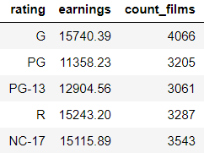
Q2. What are the top earning film genres for stocking accordingly?
Bucket film genres into 4 levels of rental earnings from the data
Observations:
15 genres are classified into 4 buckets
Top quartile consist of Sports, Sci-Fi, Animation & Drama
It is interesting to see that Animation is in first quartile and Children is in the last quartile, probably the rentals for children are from the animation genre
Business suggestion:
Discounts can be offered on films from the lower quartile genres
Offer bundled genre deals between extreme quartile genres
Quality of titles to be increased from lower quartiles
Window Functions in MySQL with Python Integration – Team 7

Slide 11
What is the frequency of payment services offered by each staff?
Using first_value and last_value calculate the duration in hours of payment_date per day. Then take the count of payments received and divide by duration in hours calculated.
Window Functions in MySQL with Python Integration – Team 7

Slide 12
Learnings & Conclusions
Importance of window functions and its applications
Python – SQL integration → querying data and creating data frames for further analyses in Python
Further Scope for Improvement:
Window Functions in MySQL with Python Integration – Team 7

Slide 13
NTILE() – Overview and Logic
NTILE() function is used to divide data into Tiles(Groups) and returns the number of the tile to which the row belongs.
Part of the family ranking functions.
Format: NTILE(n) OVER (PARTITION BY <expression>[{,<expression>...}]
ORDER BY <expression> [ASC|DESC], [{,<expression>...}] )
Window Functions in MySQL with Python Integration – Team 7

Slide 14
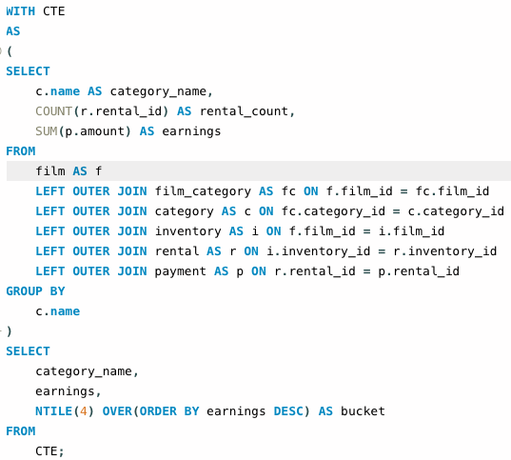
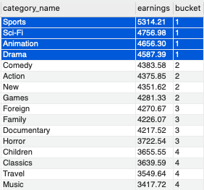
Classify the film genres into buckets based on top earnings ?
Window Functions in MySQL with Python Integration – Team 7

Slide 15
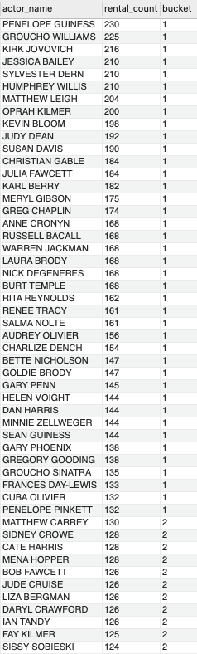
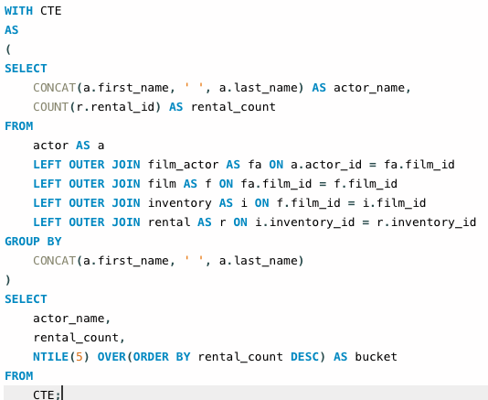
Classify actors into buckets of most rented (demand)?
Window Functions in MySQL with Python Integration – Team 7

Slide 16
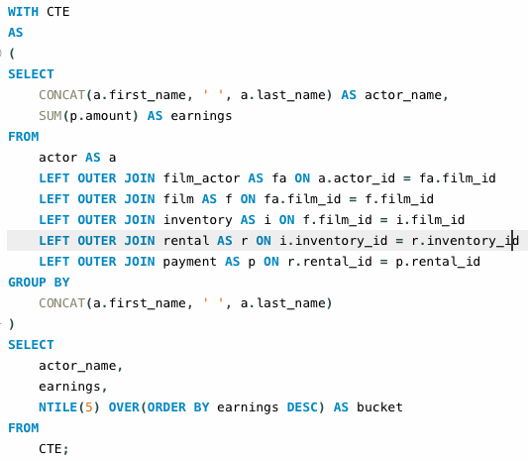
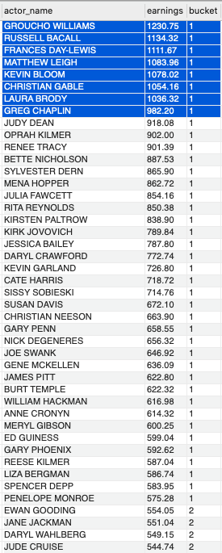
Which actors are most promising to invest based on current earnings?
Window Functions in MySQL with Python Integration – Team 7

Slide 17
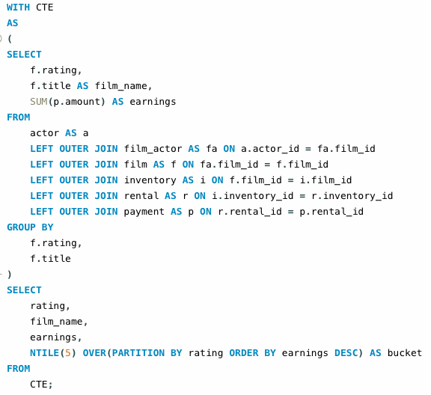
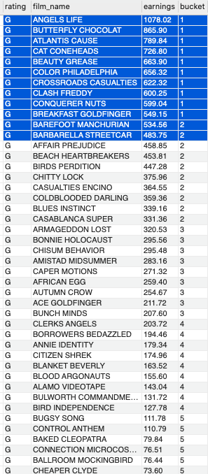
Bucket list of movies based on ratings and best earnings?
Window Functions in MySQL with Python Integration – Team 7

Slide 18
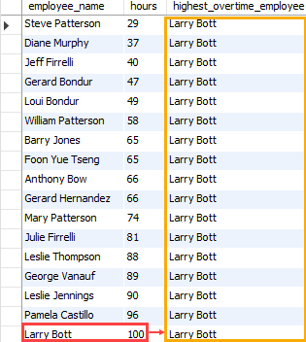
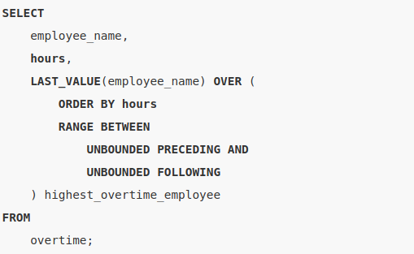
LAST_VALUE() Function Overview
The LAST_VALUE() function is a window function that allows you to select the last row in an ordered set of rows.
It returns the value of the expression from the last row of a sorted set of rows.
The following shows the syntax of the LAST_VALUE() function:
LAST_VALUE ( scalar_expression ) OVER ( [PARTITION BY partition_expression, ... ]ORDER BY sort_expression [ASC | DESC], ... )
LAST_VALUE() over the whole query result example
Window Functions in MySQL with Python Integration – Team 7

Slide 19
LAST_VALUE() Function Overview
scalar_expression
scalar_expression is an expression evaluated against the value of the last row in an ordered partition of the result set. The scalar_expression can be a column, subquery, or expression evaluates to a single value. It cannot be a window function.
PARTITION BY clause
The PARTITION BY clause distributes rows of the result set into partitions to which the LAST_VALUE() function is applied. If you skip the PARTITION BY clause, the LAST_VALUE() function will treat the whole result set as a single partition.
ORDER BY clause
The ORDER BY clause specifies the logical order of the rows in each partition to which the LAST_VALUE()function is applied.
rows_range_clause
The rows_range_clause further limits the rows within a partition by defining start and end points.
Window Functions in MySQL with Python Integration – Team 7

Slide 20
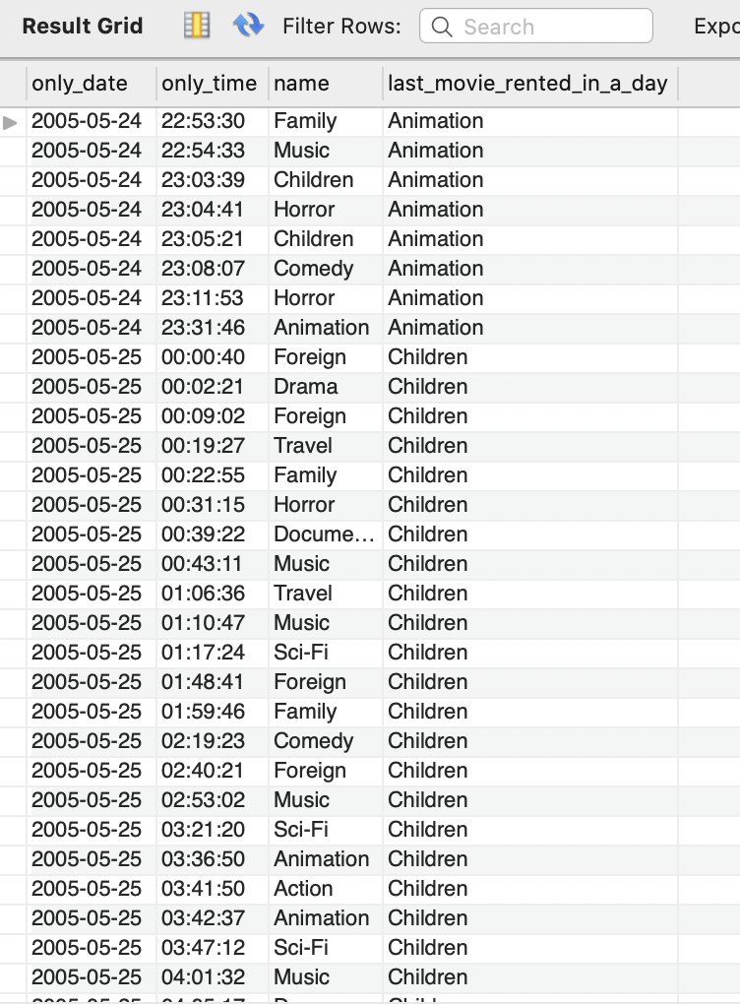
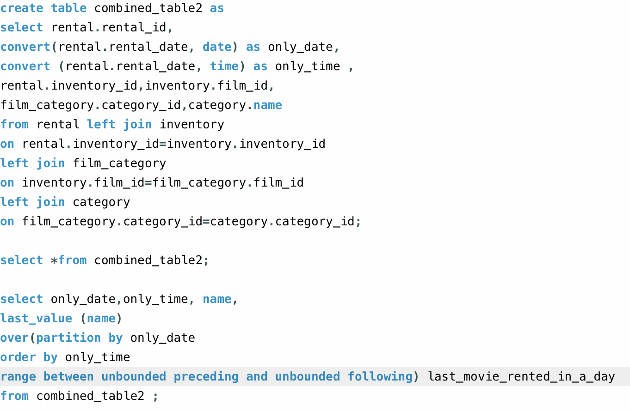
LAST_VALUE() questions addressed on Sakila
Question 1 -
What is the genre of the last movie rented in a day?
-- Used 4 Table join on rental , inventory , film_category, category tables
Window Functions in MySQL with Python Integration – Team 7

Slide 21
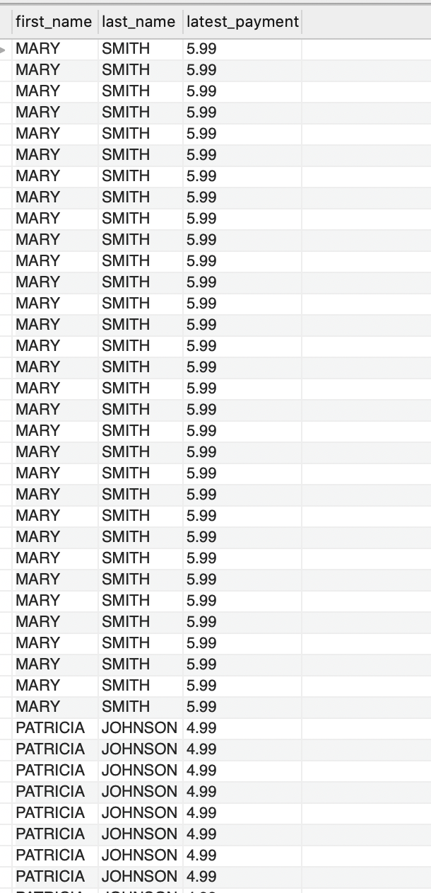
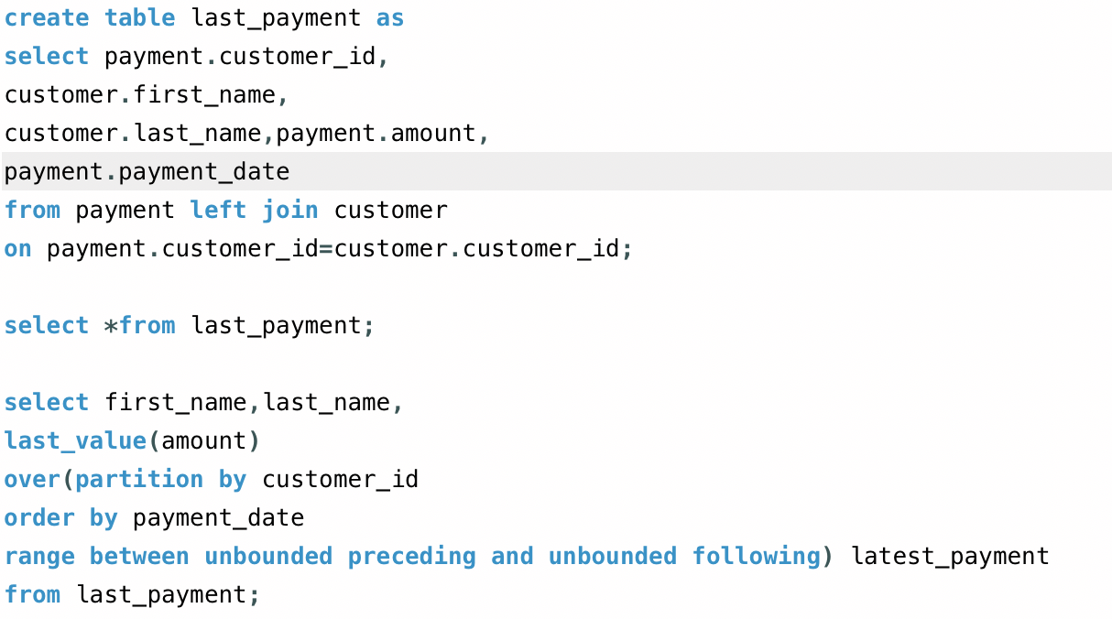
LAST_VALUE() questions addressed on Sakila
Question 2-
What is the last/ latest payment of customer from the given data (name of the customer also to be queried)?
-- Joined payment table and customer table and applied Last_Value()
Window Functions in MySQL with Python Integration – Team 7

Slide 22
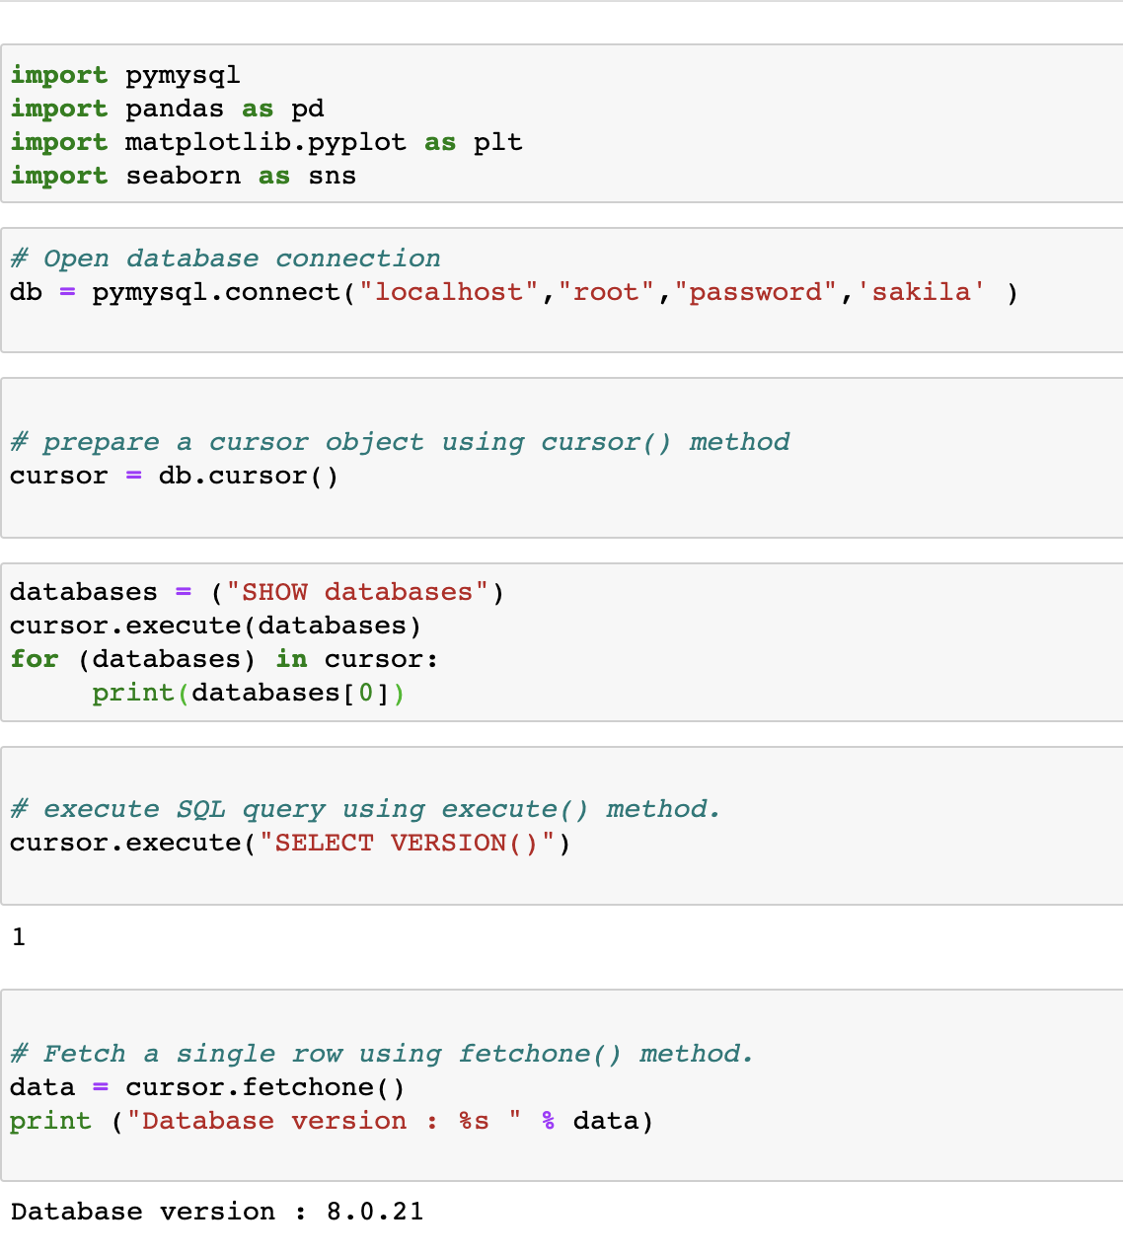
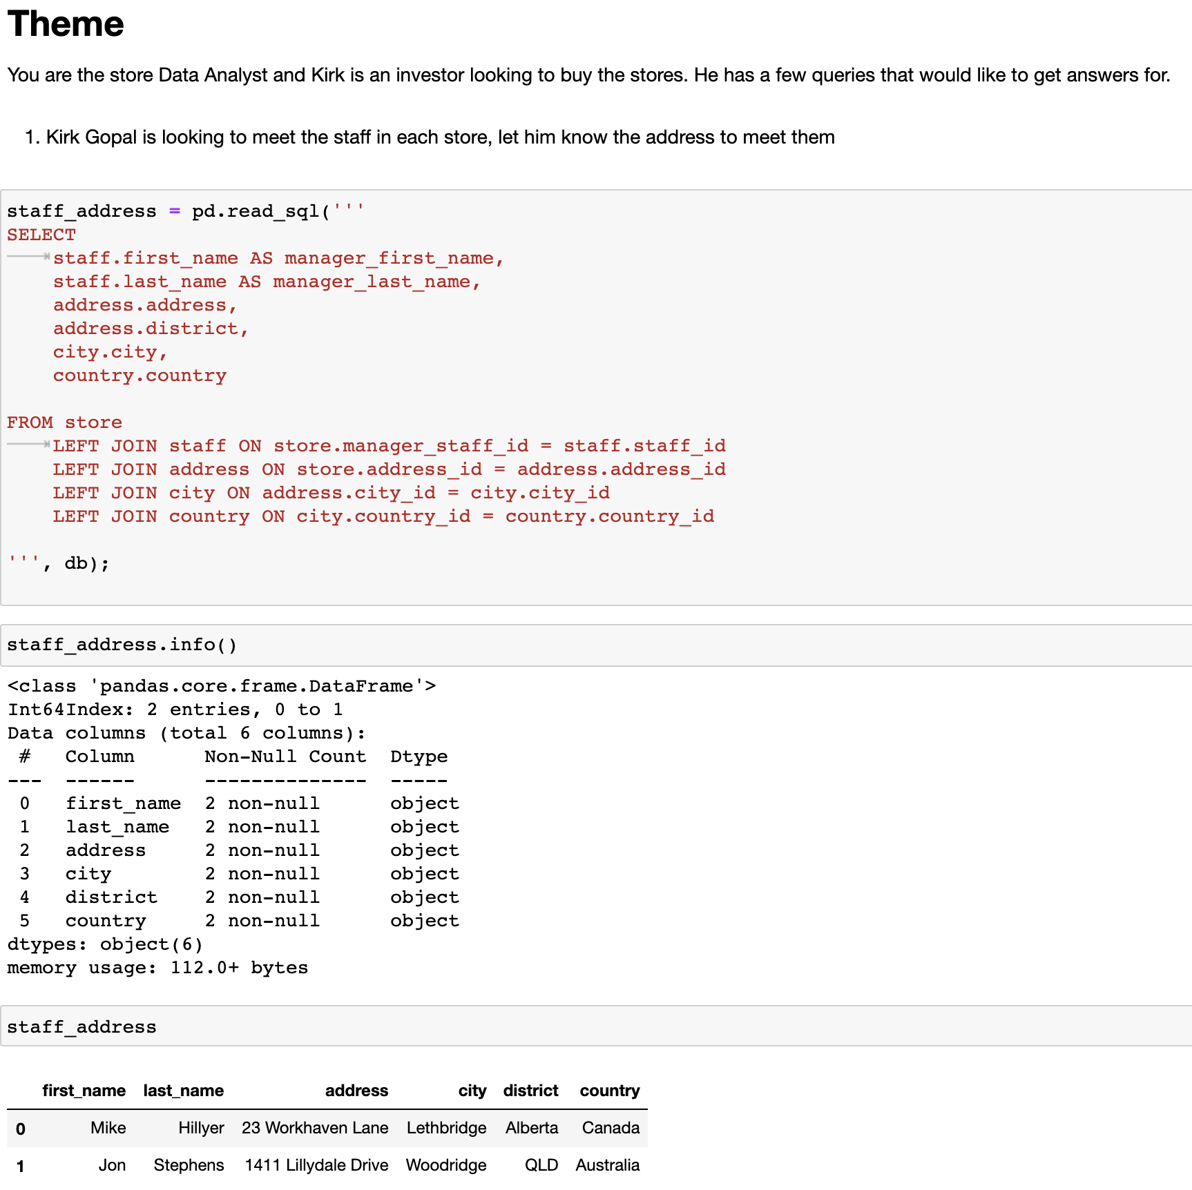
Python and SQL Connectivity, Sample 1
Window Functions in MySQL with Python Integration – Team 7

Slide 23
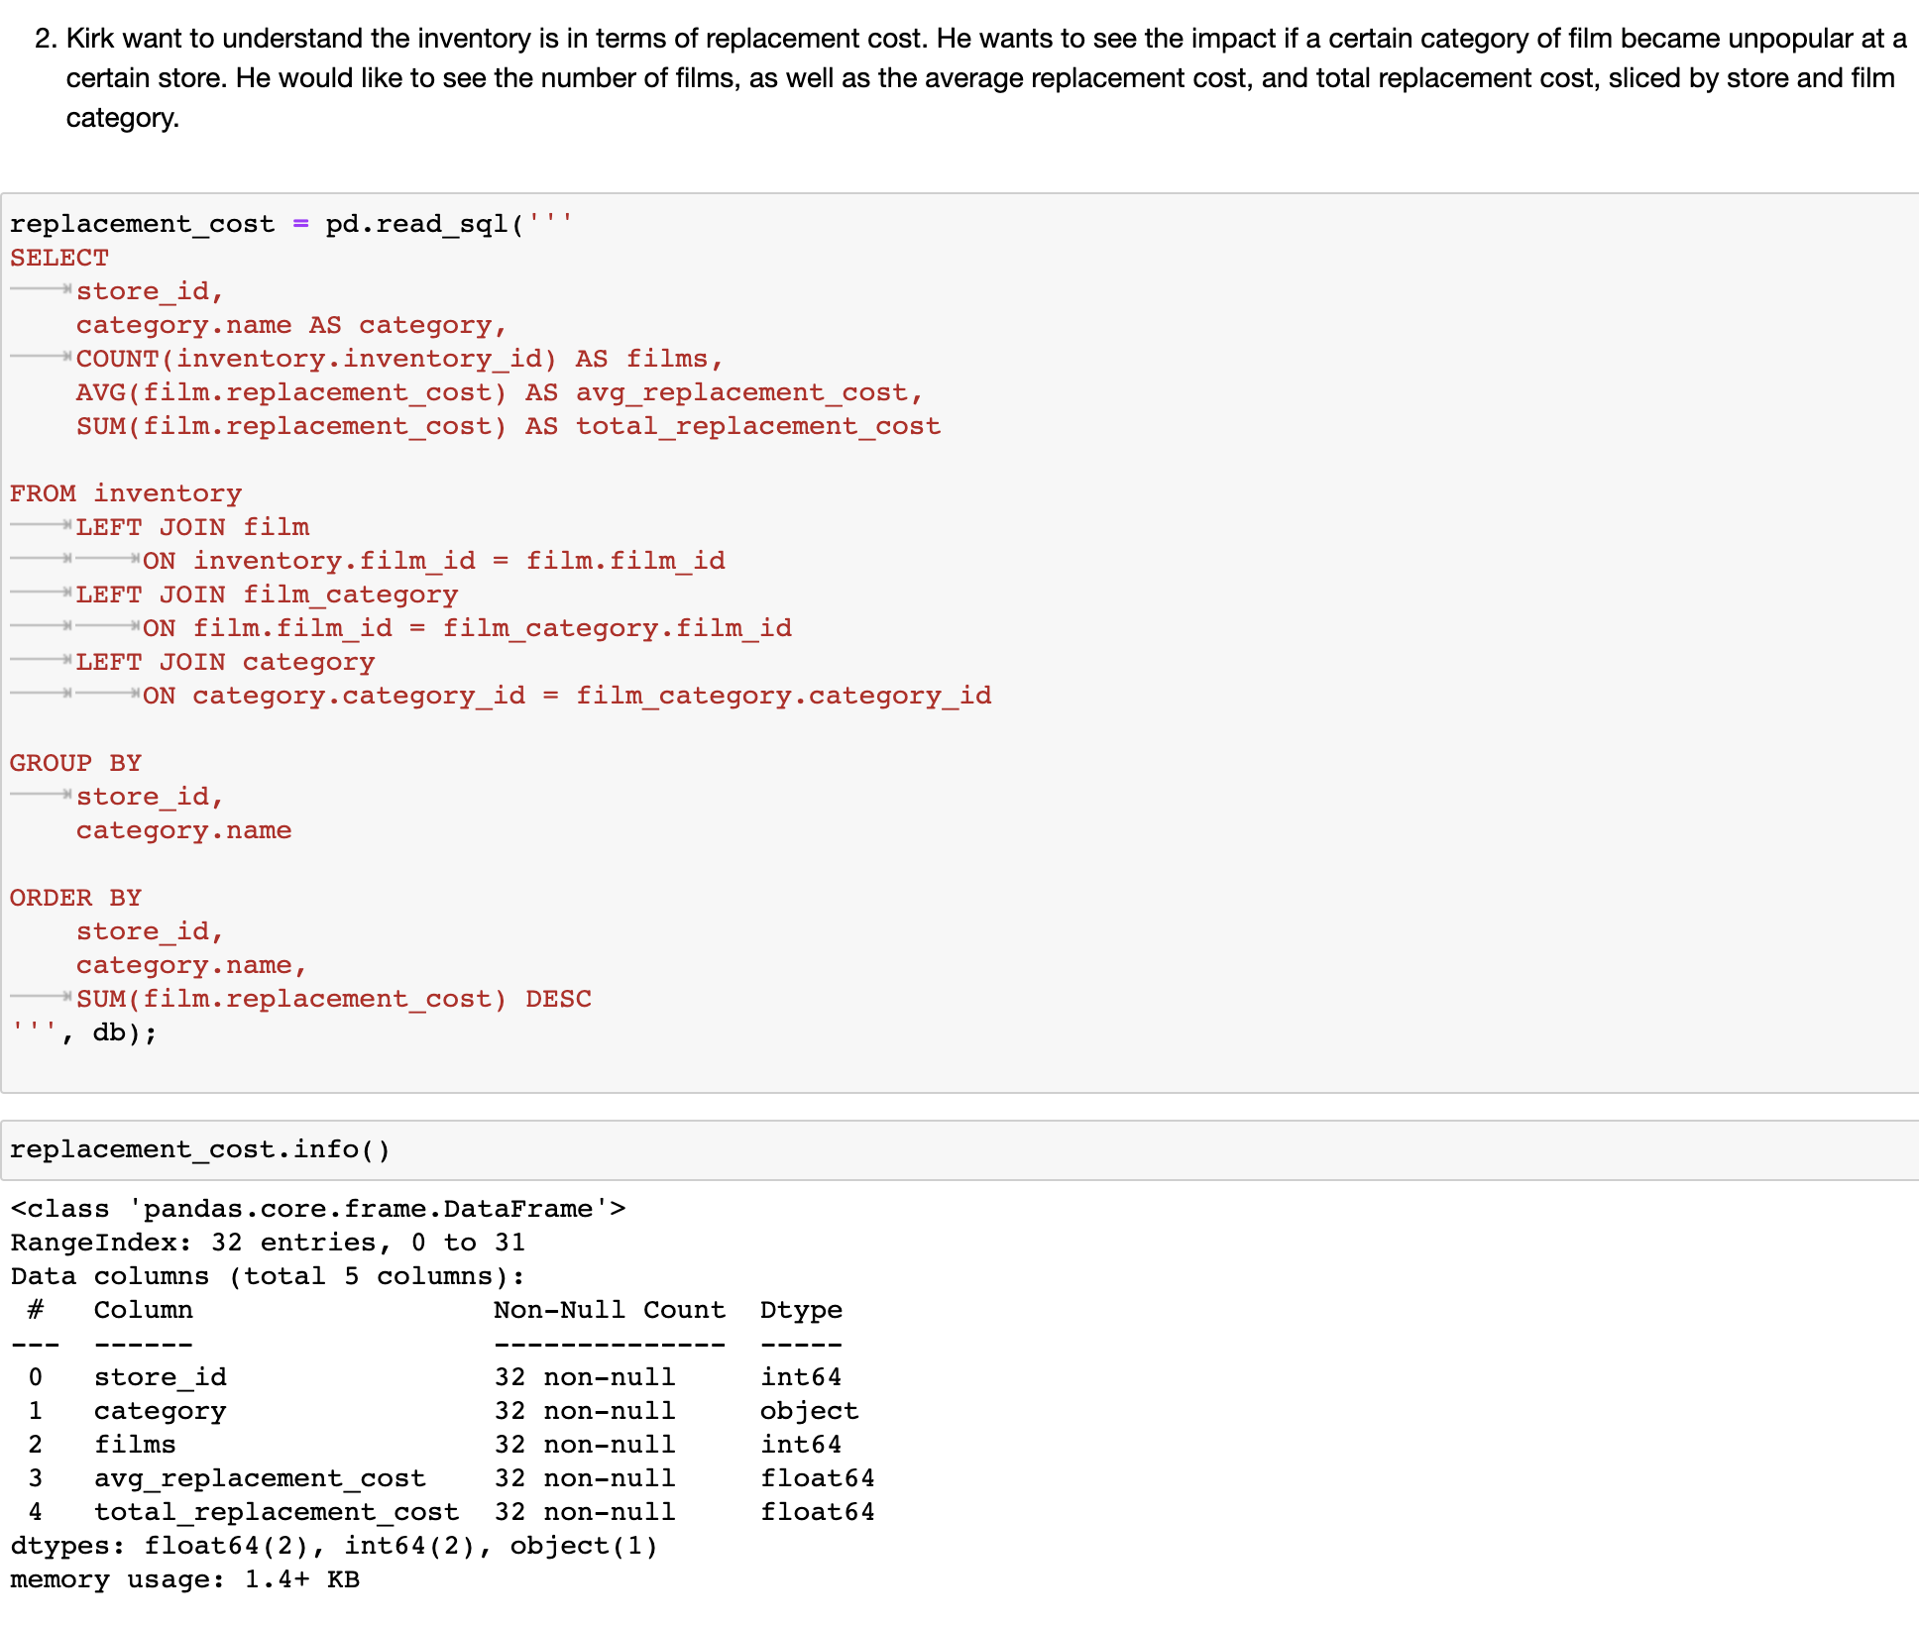
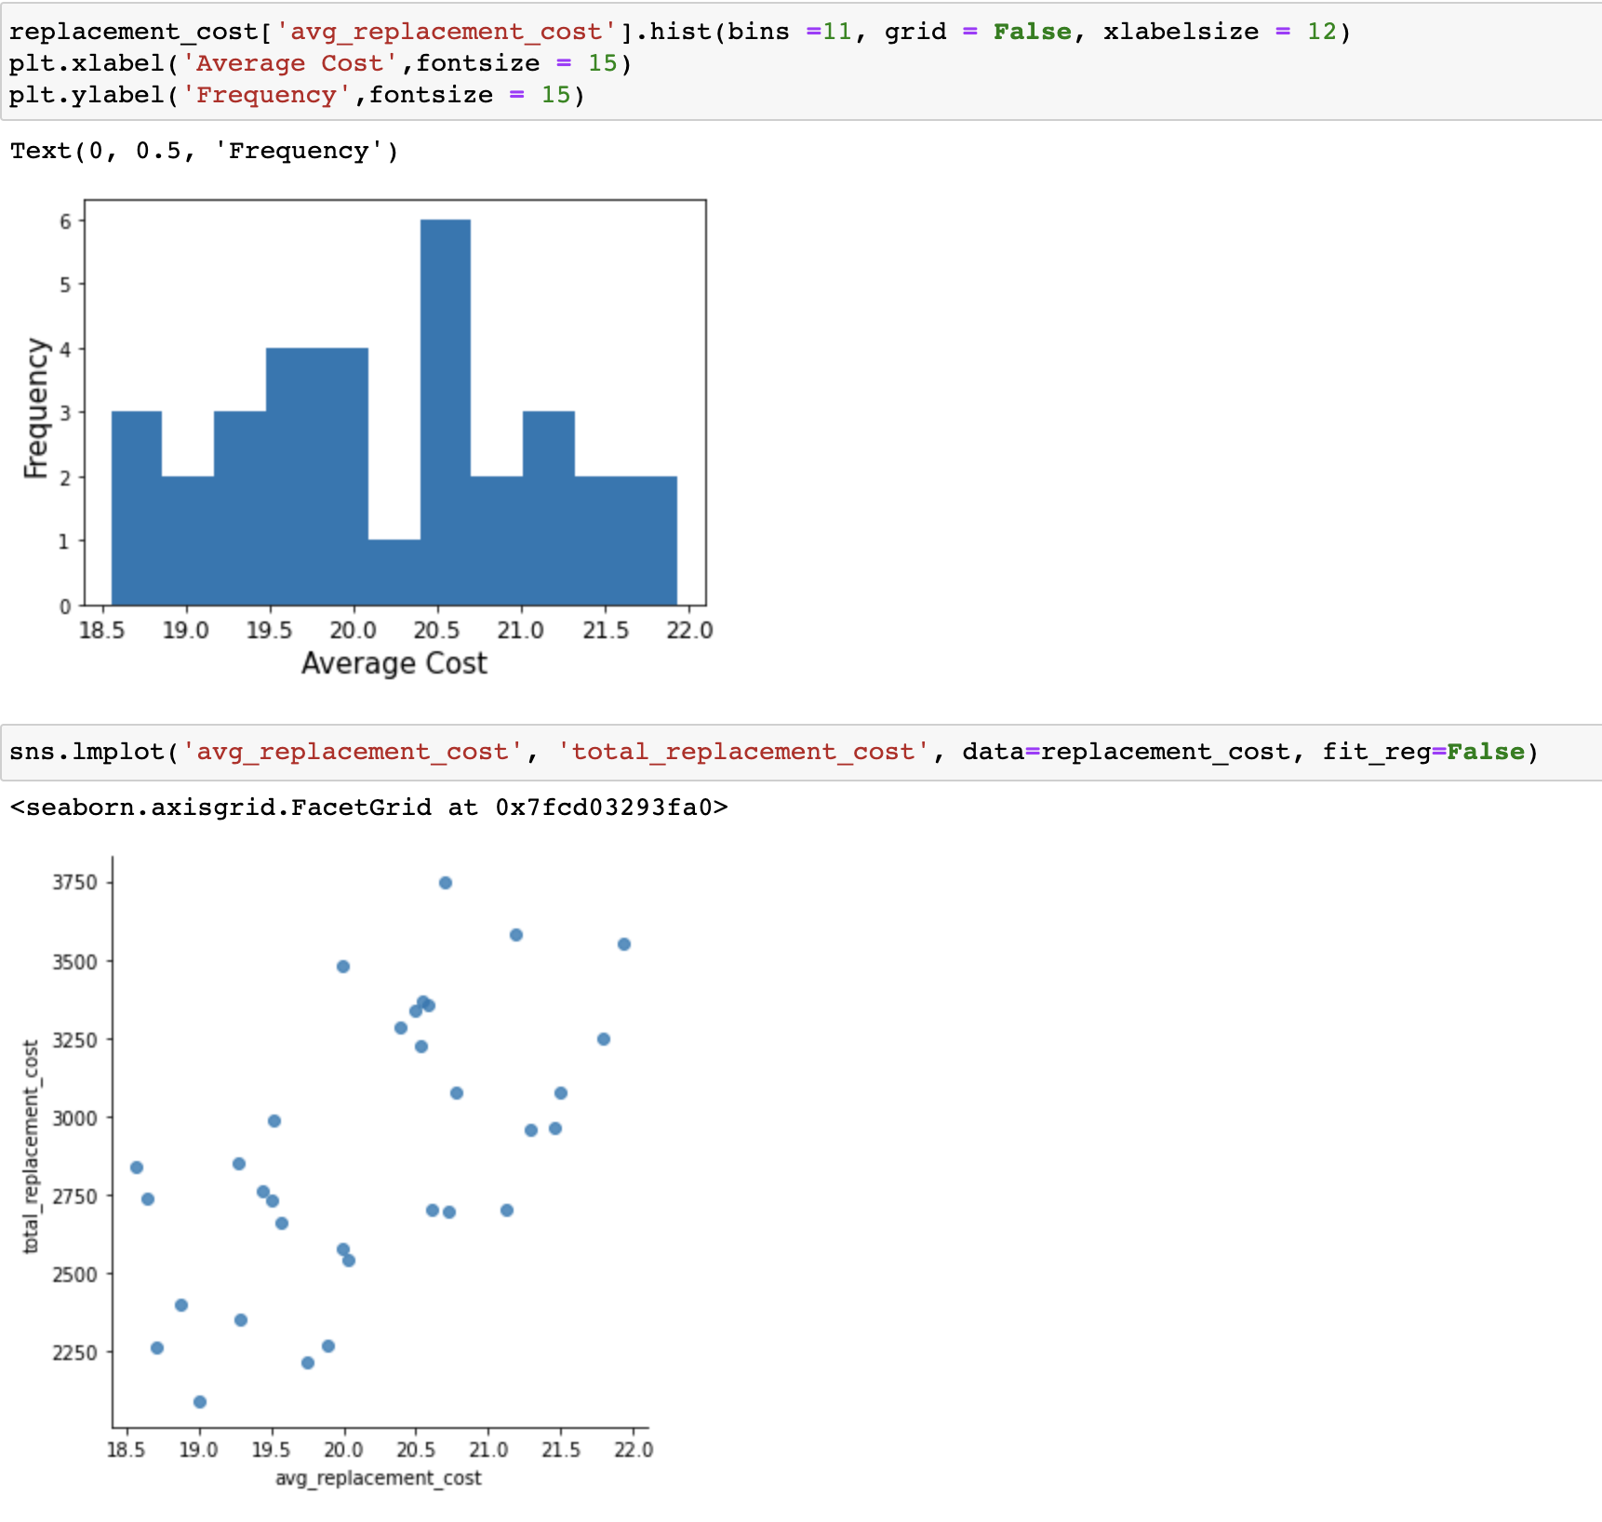
A Multiple Join Query - Sample 2
Window Functions in MySQL with Python Integration – Team 7

Slide 24
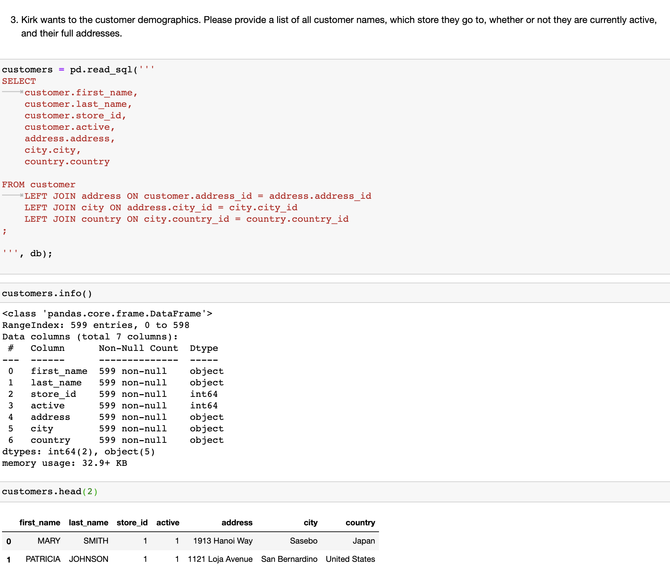
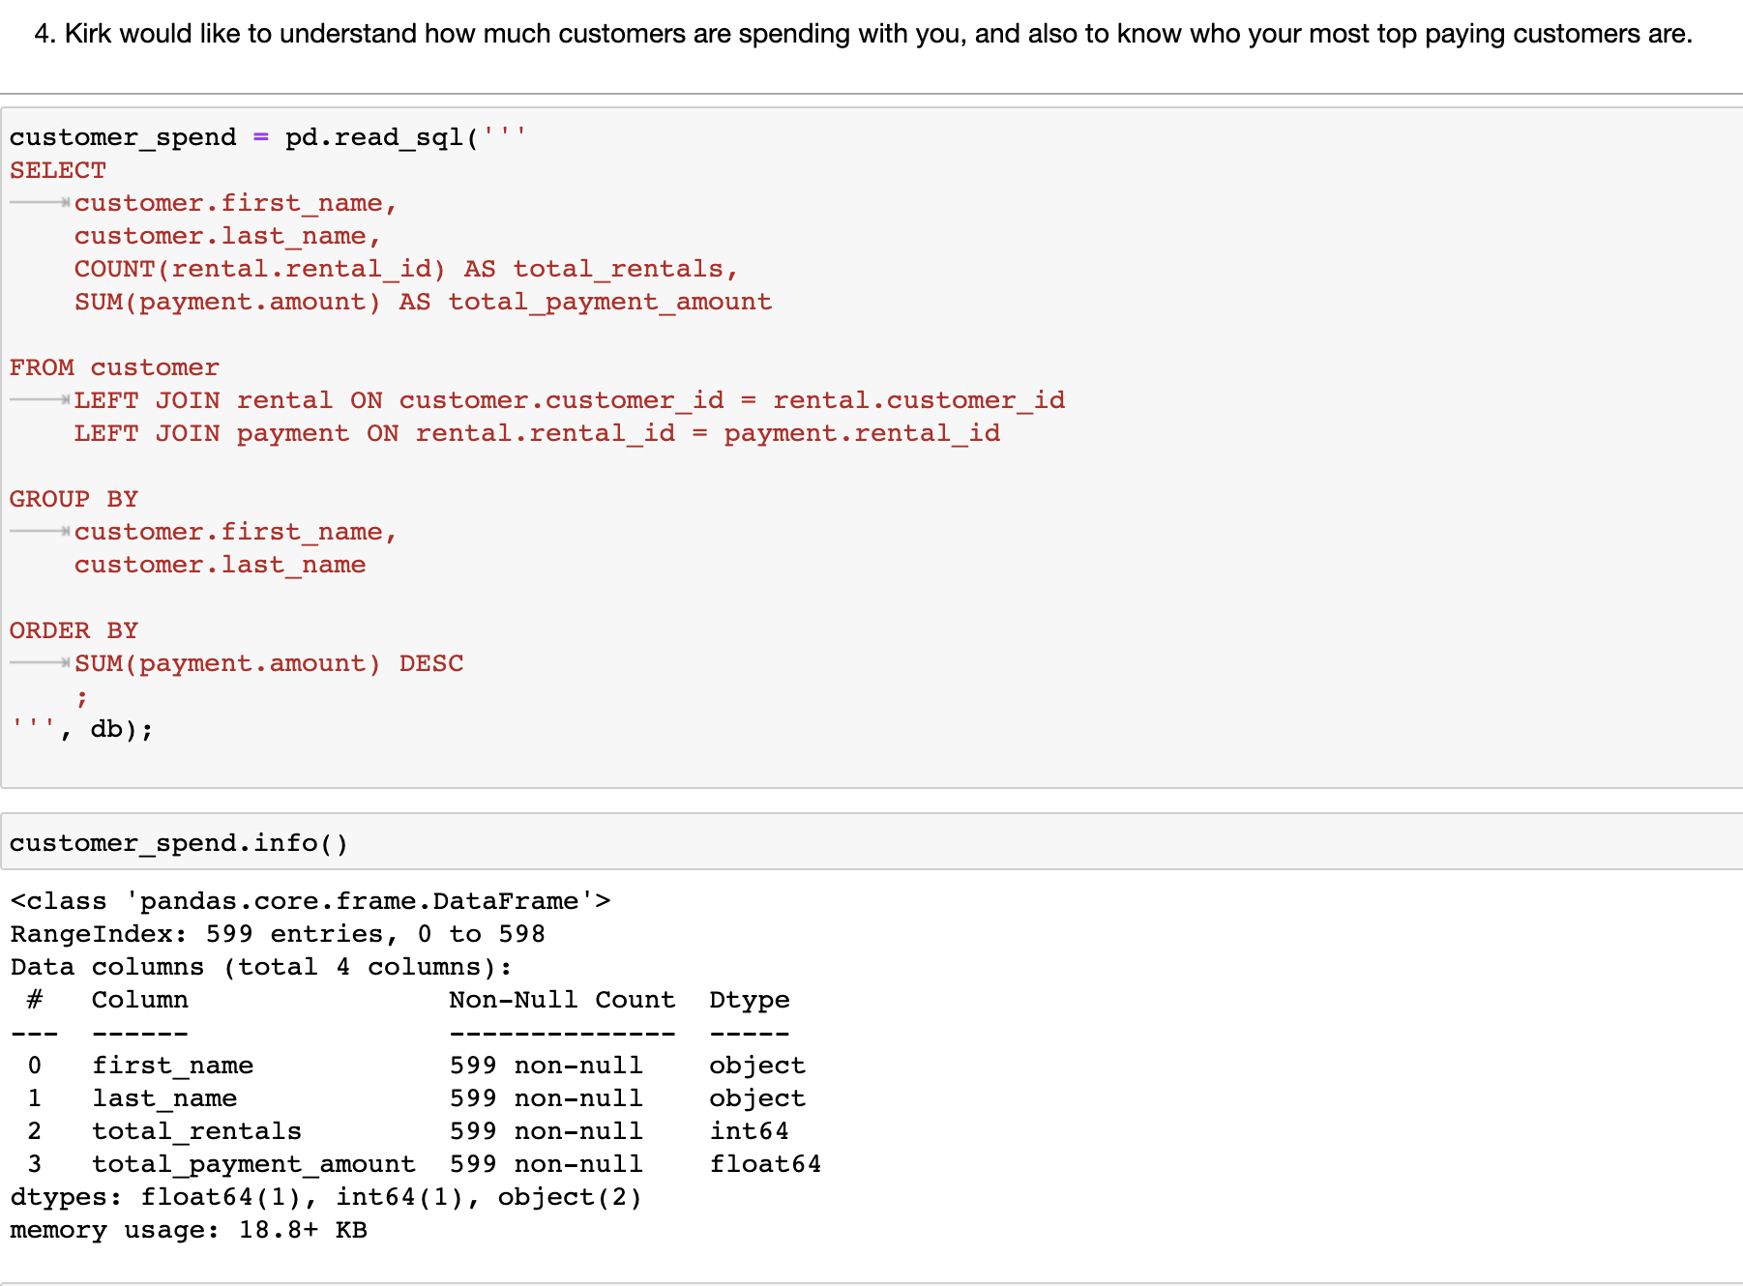
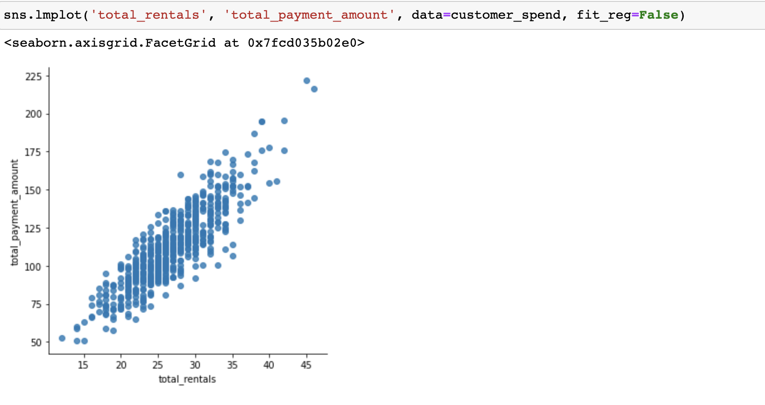
A Multiple Join Query - Sample 3 & 4
Window Functions in MySQL with Python Integration – Team 7

Slide 25
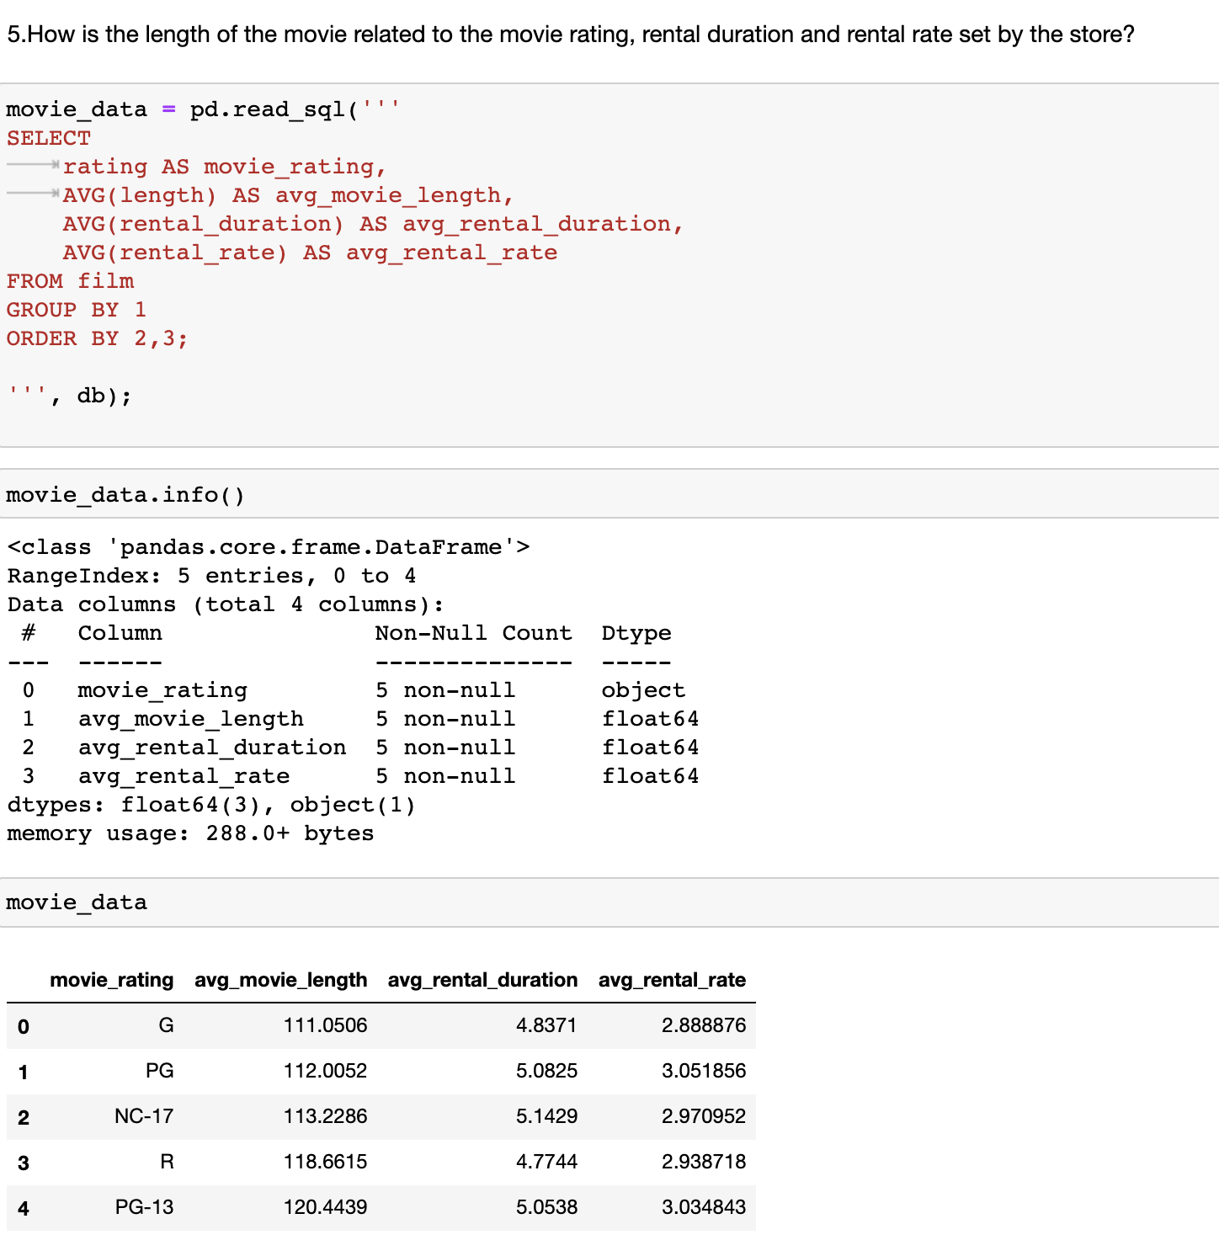
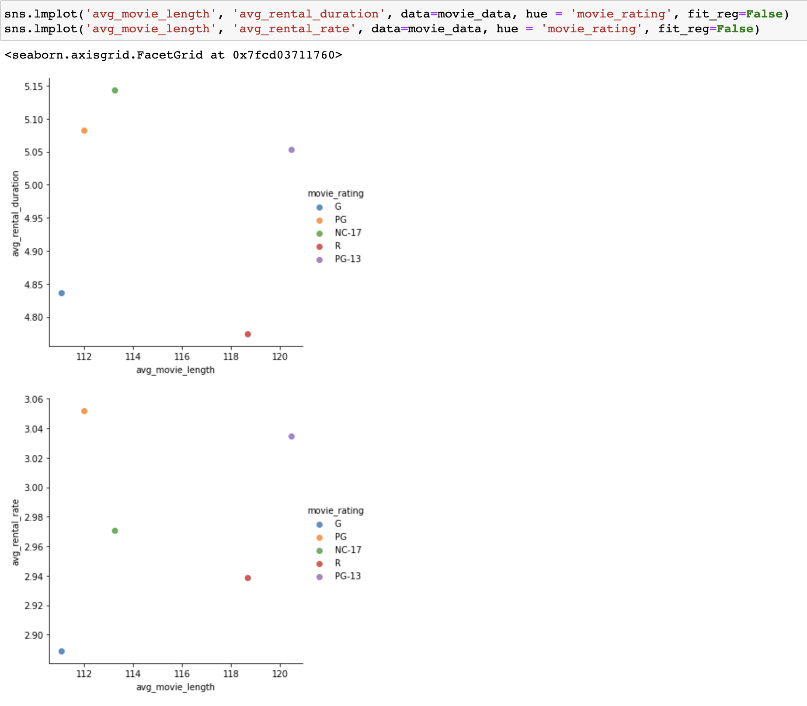
Another Query - Sample 5
Window Functions in MySQL with Python Integration – Team 7

Slide 26
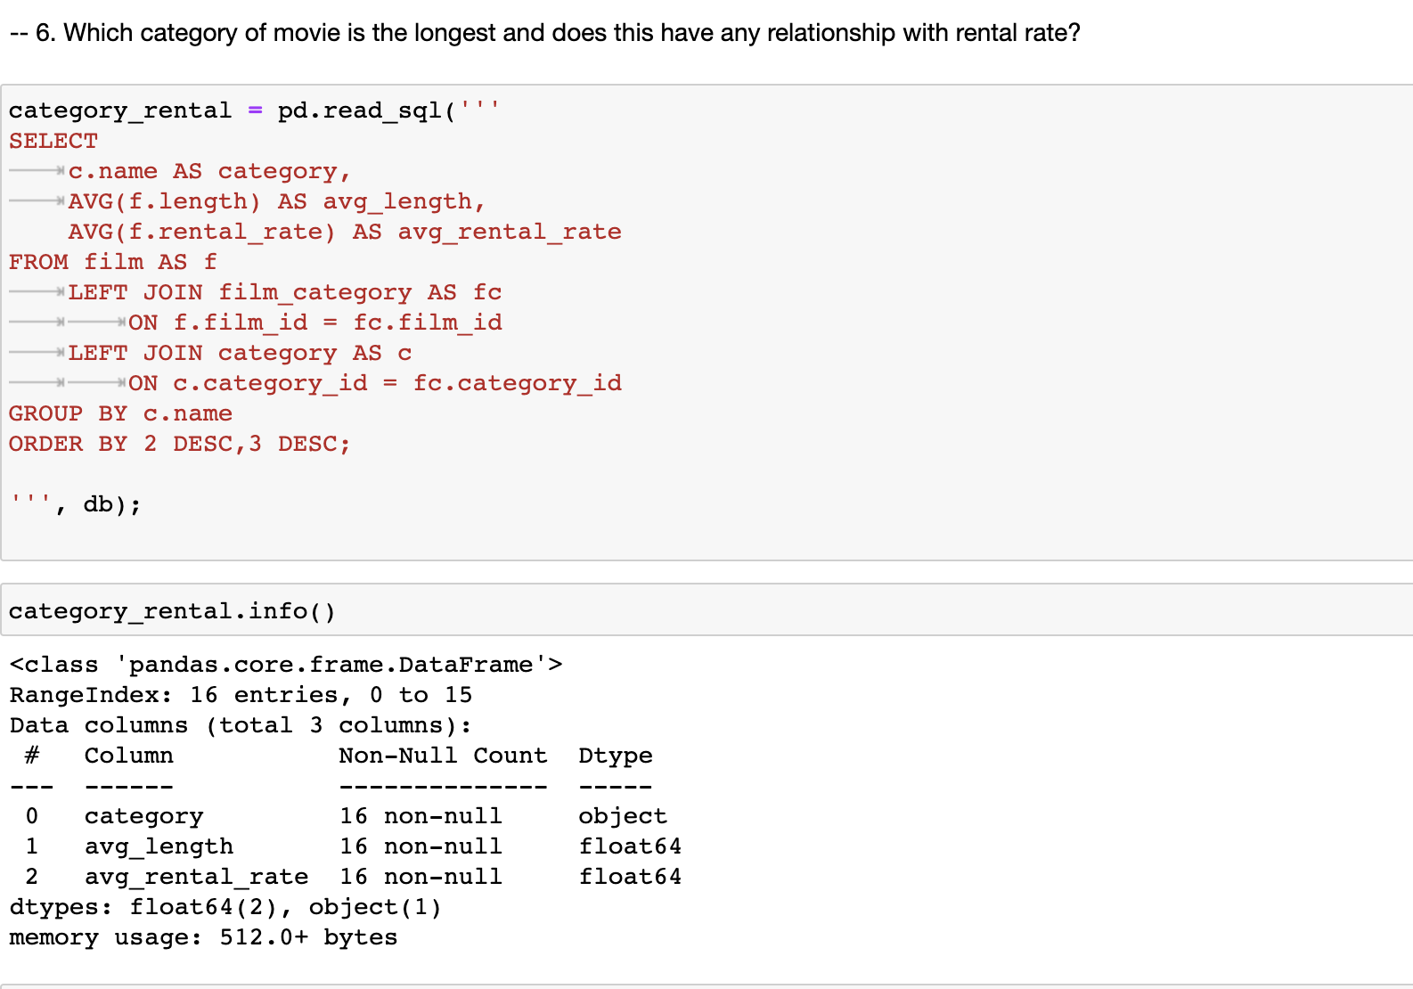
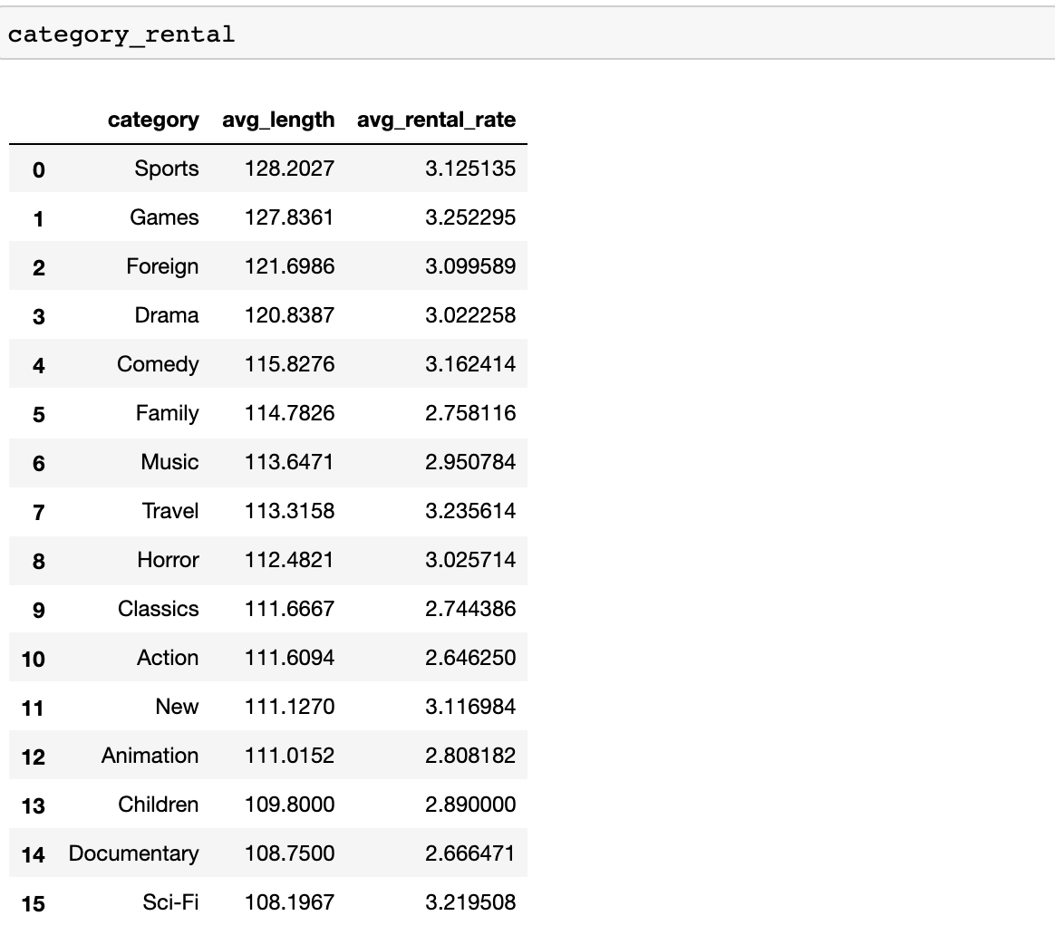
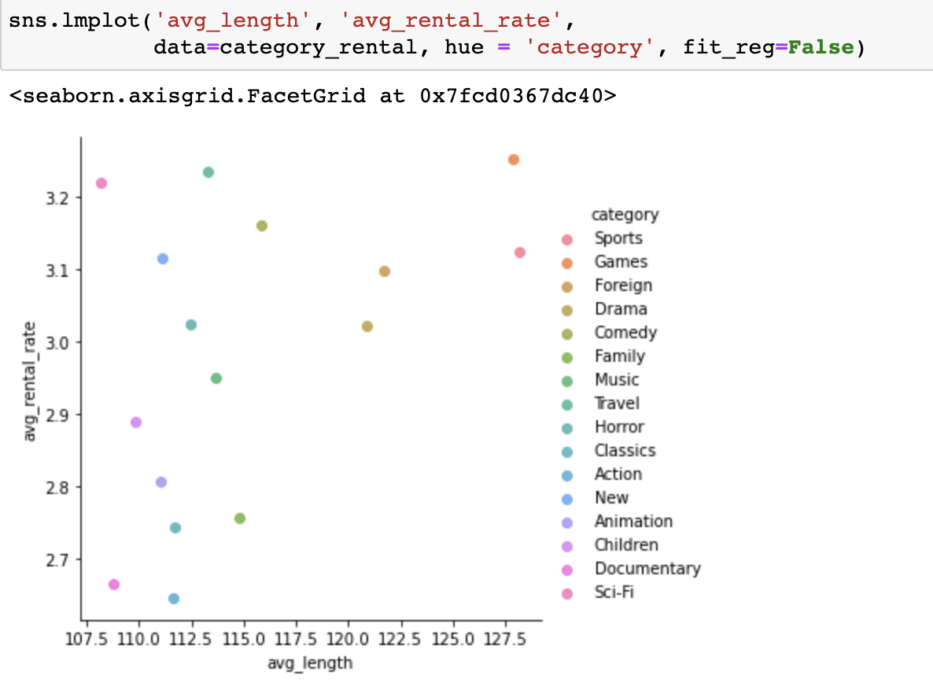
Another Query - Sample 6
Window Functions in MySQL with Python Integration – Team 7

Slide 27
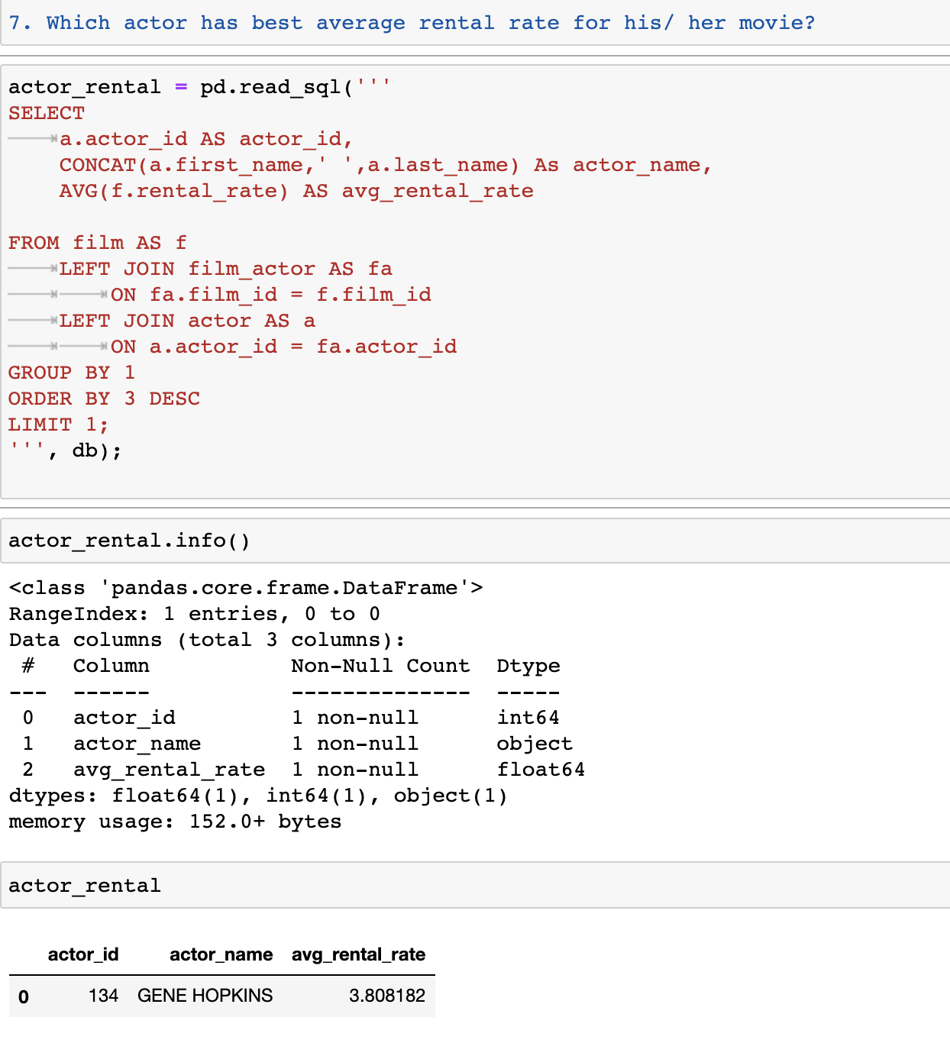
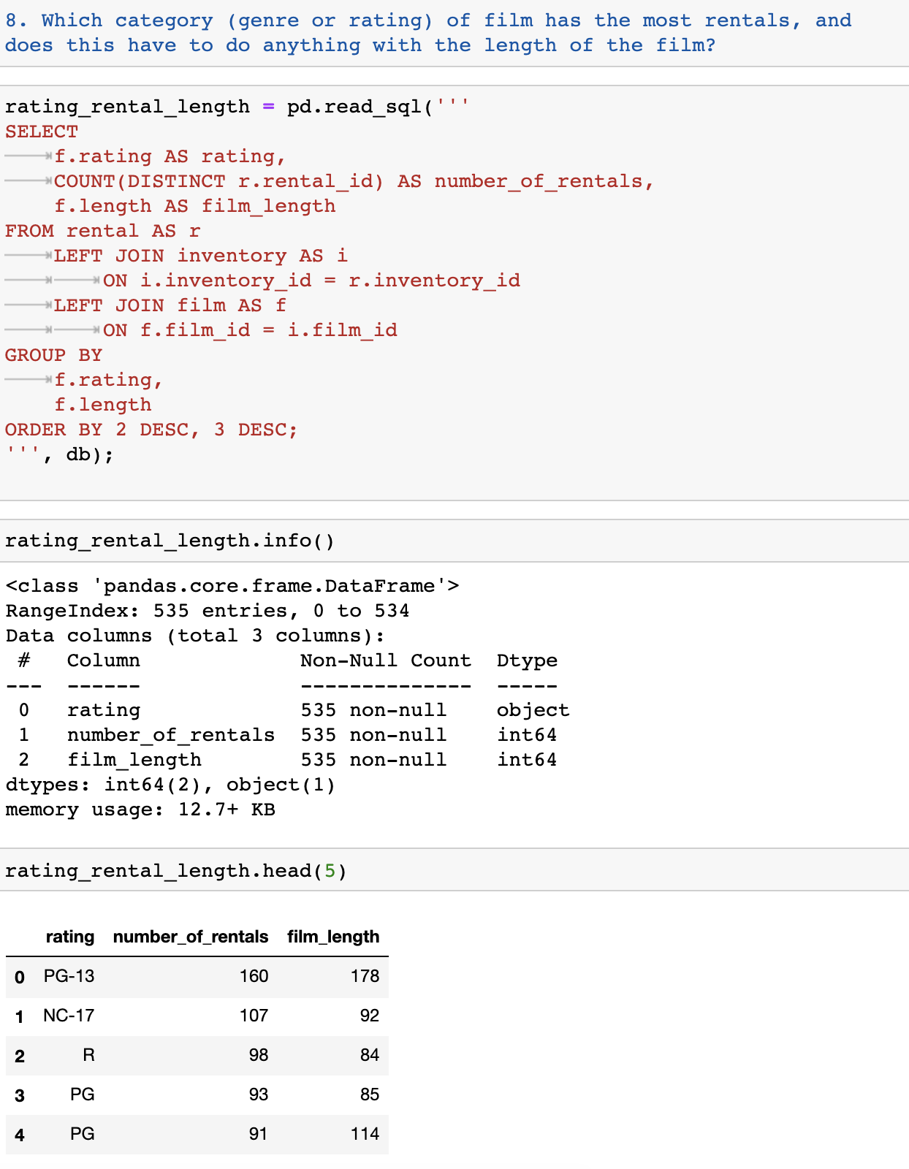
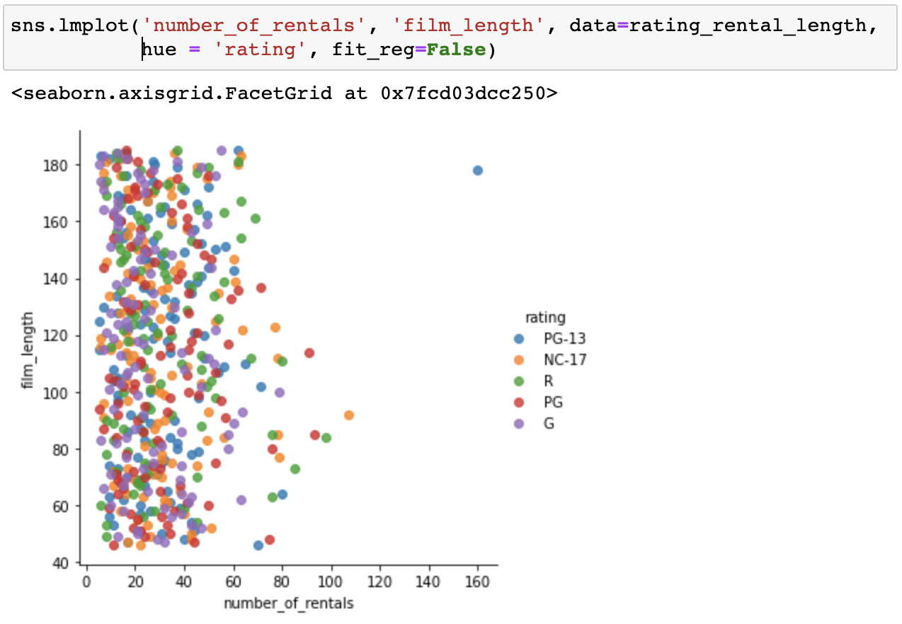
Another Query - Sample 7 & 8
Window Functions in MySQL with Python Integration – Team 7

Slide 28
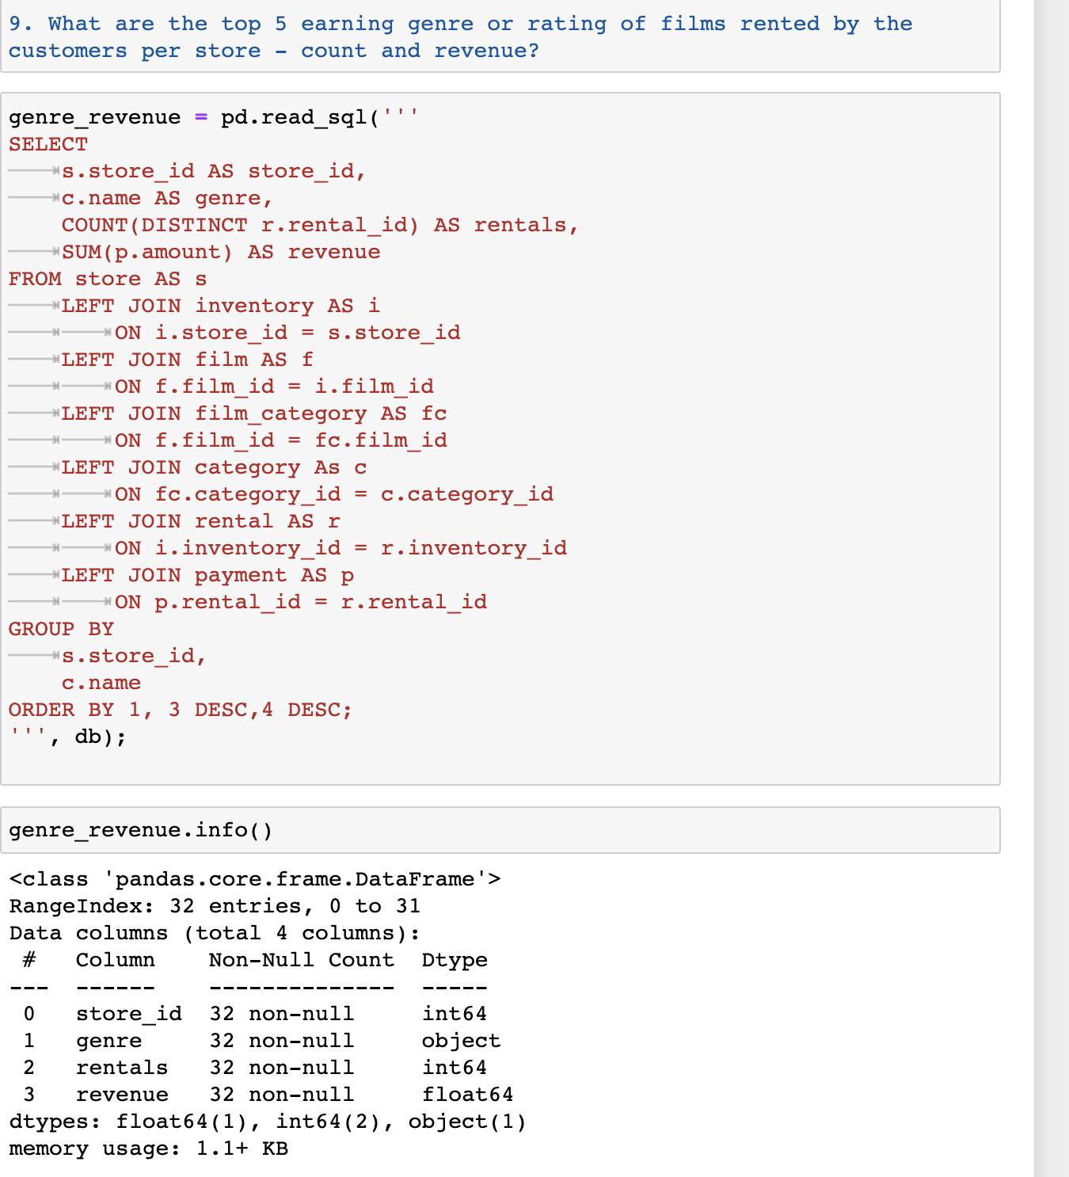
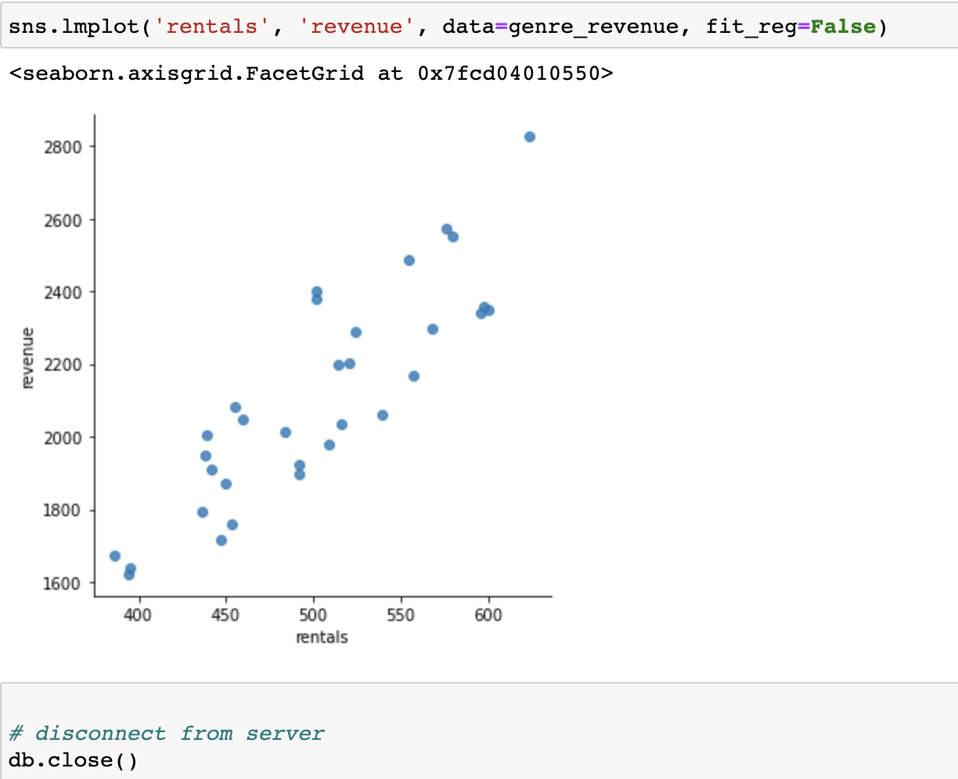
Another Query - Sample 11
Window Functions in MySQL with Python Integration – Team 7

Slide 29
Thank You!
Project Team
PRAVEEN MANOHAR G
RAHUL A
RAJESH RAMACHANDER
RANJITH GNANA SUTHAKAR ALPHONSE RAJ
Github link to codebase
https://github.com/RajeshRamachander/mysqlpython

